Slide 1
How F# Learned to Stop Worrying and Love the Data
Tomas Petricek
tomas@tomasp.net | @tomaspetricek
PhD Student at University of Cambridge
& Coordinator of http://fsharp.org

Slide 2
Tomas Petricek
PhD @ University of Cambridge
Tracking context-dependence Type-providers & Reactive & Web
F# Community Contributor
Open-source libraries, F# Foundation

Slide 3
software stacks trainings teaching F# user groups snippets mac and linux community books and tutorials
F# Software Foundation
consulting open-source MonoDevelop
http://www.fsharp.org
contributions research support cross-platform mailing lists

Slide 4

The Data

Slide 5

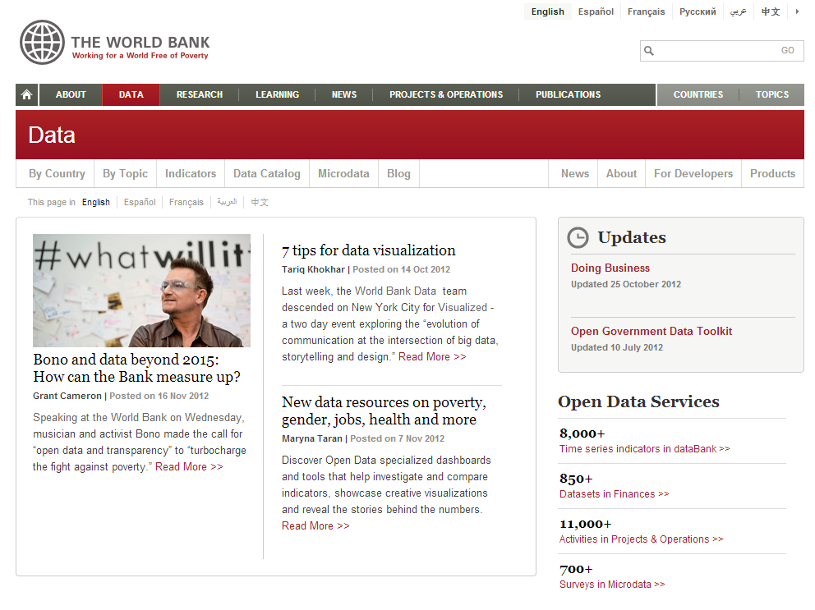
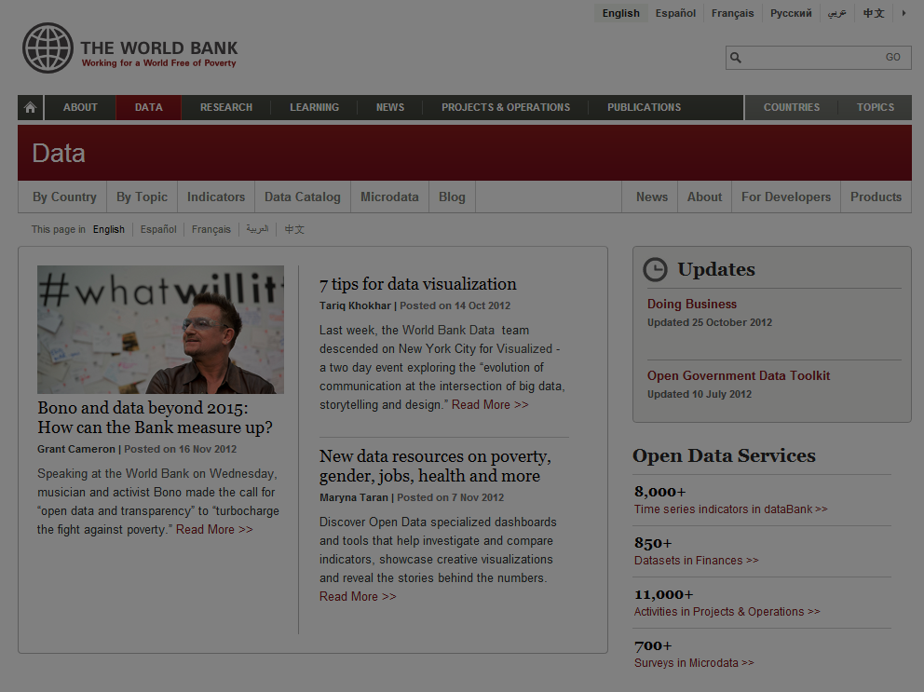

Slide 6
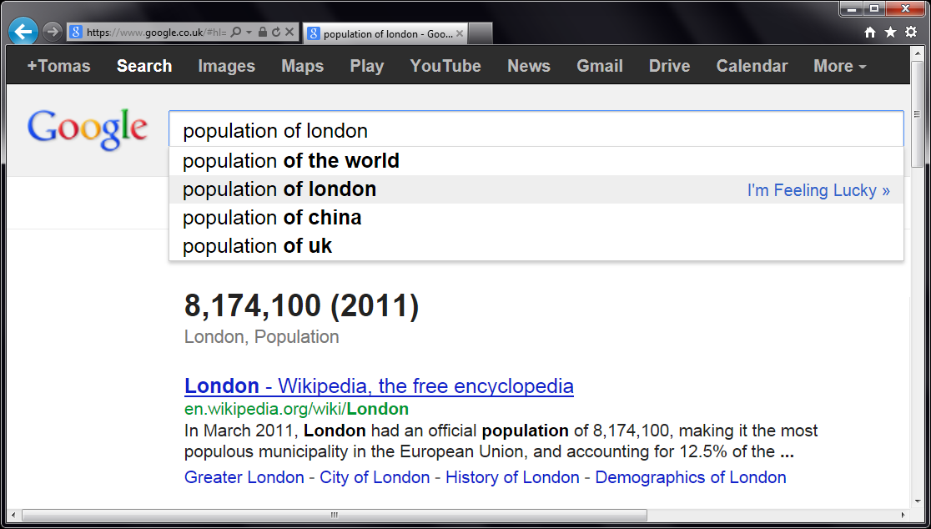
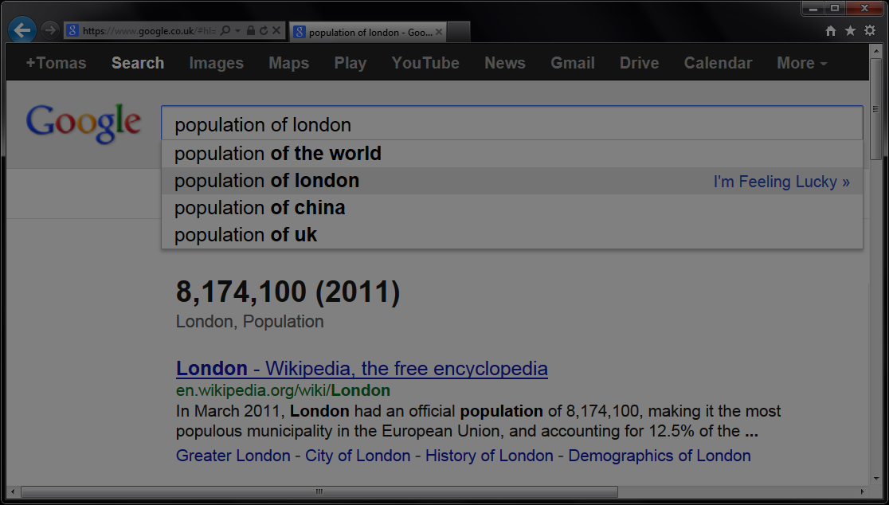

Slide 7

Demo: Understanding the world

Slide 8
Integrate everything!
Data sources
REST & web services Open government data
Languages and tools
“Rewrite everything” is wrong

Slide 9
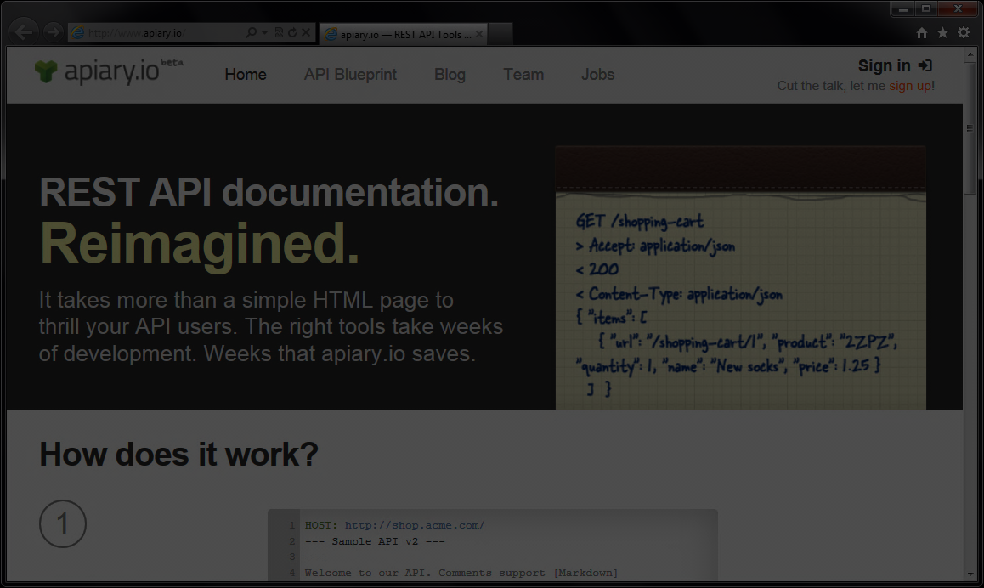
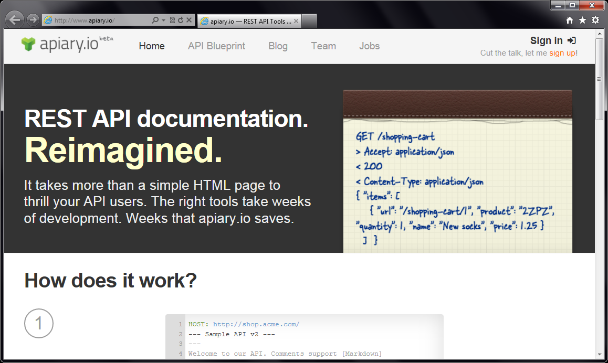
Accessing REST services

Slide 10

Demo: Searching movie database

Slide 11
Web and JavaScript
Accessing untyped data
There is always schema Examples work surprisingly well
Running as JavaScript
Good language still matters

Slide 12
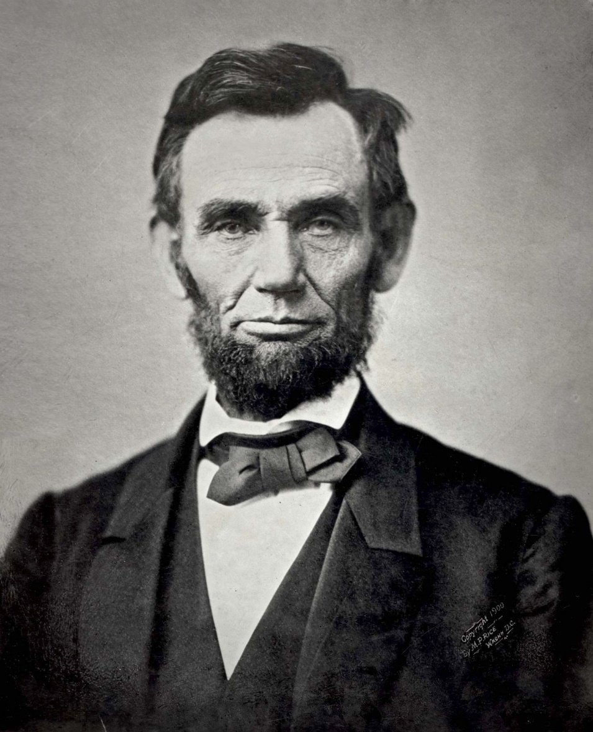
Demo: US debt over the last century

Slide 13
Data Science
Matlab, R studio, Mathematica
Poor languages & Great tools
Data Science in F#
Great language & Poor tools

Slide 14
Summary

Slide 15
Type Providers in Action
WorldBank provider
JSON and CSV providers
Apiary provider
R and TypeScript provider

Slide 16
F#
JSON R provider
XML CSV unstructured data.
Open Government Data custom providers Language Integration
Excel static types .
web services R provider unstructured data
documentation schema
REST API web programming
WorldBank TypeScript
Apiary

